Slide 1





Realistic Laue cameras - using McStas keywords and a look at polycrystal-samples

Slide 2


Agenda
A realistic Laue Camera – How to?
Polycrystals - how to describe them?
Combining a powder sample with a Single Crystal
Tricking the Single_crystal…
A reminder of the GROUP and SPLIT keywords
The dangerous JUMP keyword
A look at the TOPAZ and SENJU instruments

Slide 3
TOPAZ
Let us take a look at a couple of “real” instrument simulations of Laue Cameras:
They both reside in GitHub under today / 3_Laue_diffractometers_TOPAZ\& SENJU/
1. SNS TOPAZ
2. J.PARC SENJU (aka. BL18)
3. J.PARC SENJU POLY
Here you need to also copy a datafile for the J-PARC source “source_BL18.txt”
Surgeon General’s Warning: There are lots of COMPONENTS here

Slide 4
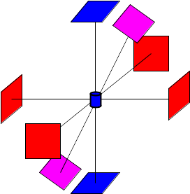



Real Laue camera
A source and a guide system delivering neutrons to the sample.
A (large) set of detectors that surround a sample.

Slide 5





Real Laue camera
Easiest way to build detector bank with spherical geometry:
Use Arms on sample position but with rotations.
… Arms cost almost nothing in computations
One arm per detector pointing at its centre → rotate it by an appropriate amount.
Place Monitors in a GROUP.
Remeber to use restore_neutron=1

Slide 6
Real Laue camera
COMPONENT a1 = Arm()
AT(0,0,0) RELATIVE sample
ROTATED (90,0,0) RELATIVE sample
COMPONENT a2 = Arm()
AT(0,0,0) RELATIVE sample
ROTATED (-90,0,0) RELATIVE sample
COMPONENT a3 = Arm()
AT(0,0,0) RELATIVE sample
ROTATED (0,90,0) RELATIVE sample
COMPONENT a4 = Arm()
AT(0,0,0) RELATIVE sample
ROTATED (0,-90,0) RELATIVE sample’
COMPONENT a5 = Arm()
AT(0,0,0) RELATIVE sample
ROTATED (-60,0,0) RELATIVE sample’
….

Slide 7
Real Laue camera
COMPONENT d1 = PSD_monitor( nx=101, ny=101,
filename=”d1”, xwidth= … )
AT(0,0,0.5) RELATIVE a1
GROUP detectors
COMPONENT d2 = COPY(d1)(filename=”d2”)
AT(0,0,0.5) RELATIVE a2
GROUP detectors
COMPONENT d3 = COPY(d1)(filename=”d3”)
AT(0,0,0.5) RELATIVE a3
GROUP detectors
COMPONENT d4 = COPY(d1)(filename=”d4”)
AT(0,0,0.5) RELATIVE a4
GROUP detectors
COMPONENT d5 = COPY(d1)(filename=”d5”)
AT(0,0,0.5) RELATIVE a5
GROUP detectors
….

Slide 8
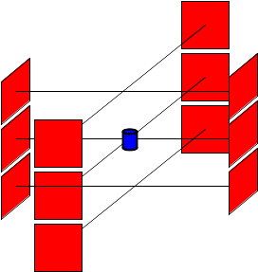
Cylindrical Laue camera
COMPONENT a1 = Arm()
AT(0,0,0) RELATIVE sample
ROTATED (90,0,0) RELATIVE sample
COMPONENT a2 = Arm()
AT(0, Y ,0) RELATIVE sample
ROTATED (90,0,0) RELATIVE sample
COMPONENT a3 = Arm()
AT(0,-Y ,0) RELATIVE sample
ROTATED (90,0,0) RELATIVE sample
COMPONENT a4 = Arm()
AT(0,0,0) RELATIVE sample
ROTATED (-90,0,0) RELATIVE sample
COMPONENT a5 = Arm()
AT(0, Y ,0) RELATIVE sample
ROTATED (-90,0,0) RELATIVE sample
…

Slide 9
J-PARC SENJU
Let us take a look at a couple of “real” instrument simulations of Laue Cameras:
They both reside in GitHub under today / 3_Laue_diffractometers_TOPAZ\& SENJU/
1. SNS TOPAZ
2. J.PARC SENJU (aka. BL18)
3. J.PARC SENJU POLY
Here you need to also copy a datafile for the J-PARC source “source_BL18.txt”
Surgeon General’s Warning: There are lots of COMPONENTS here

Slide 10
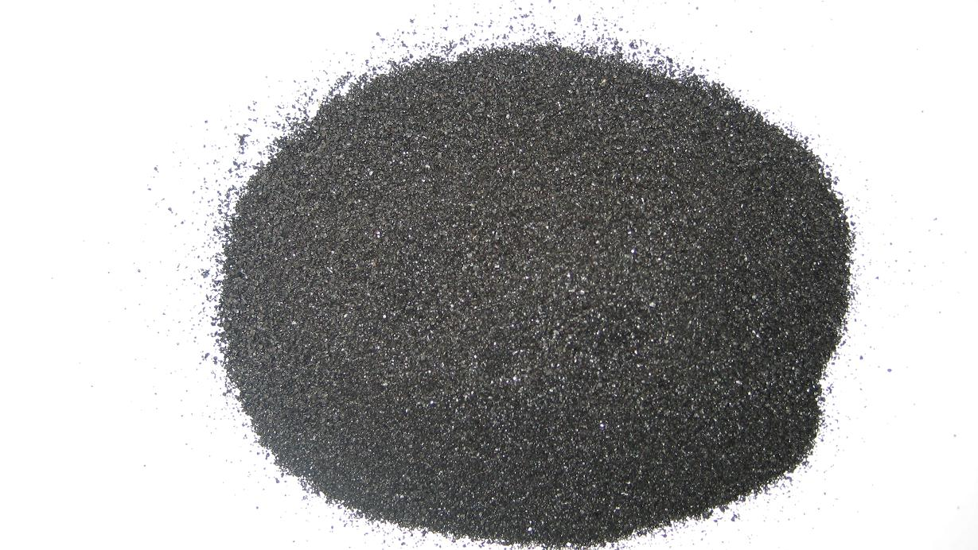
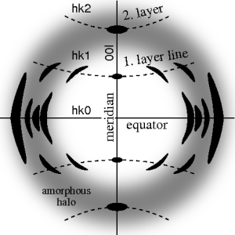
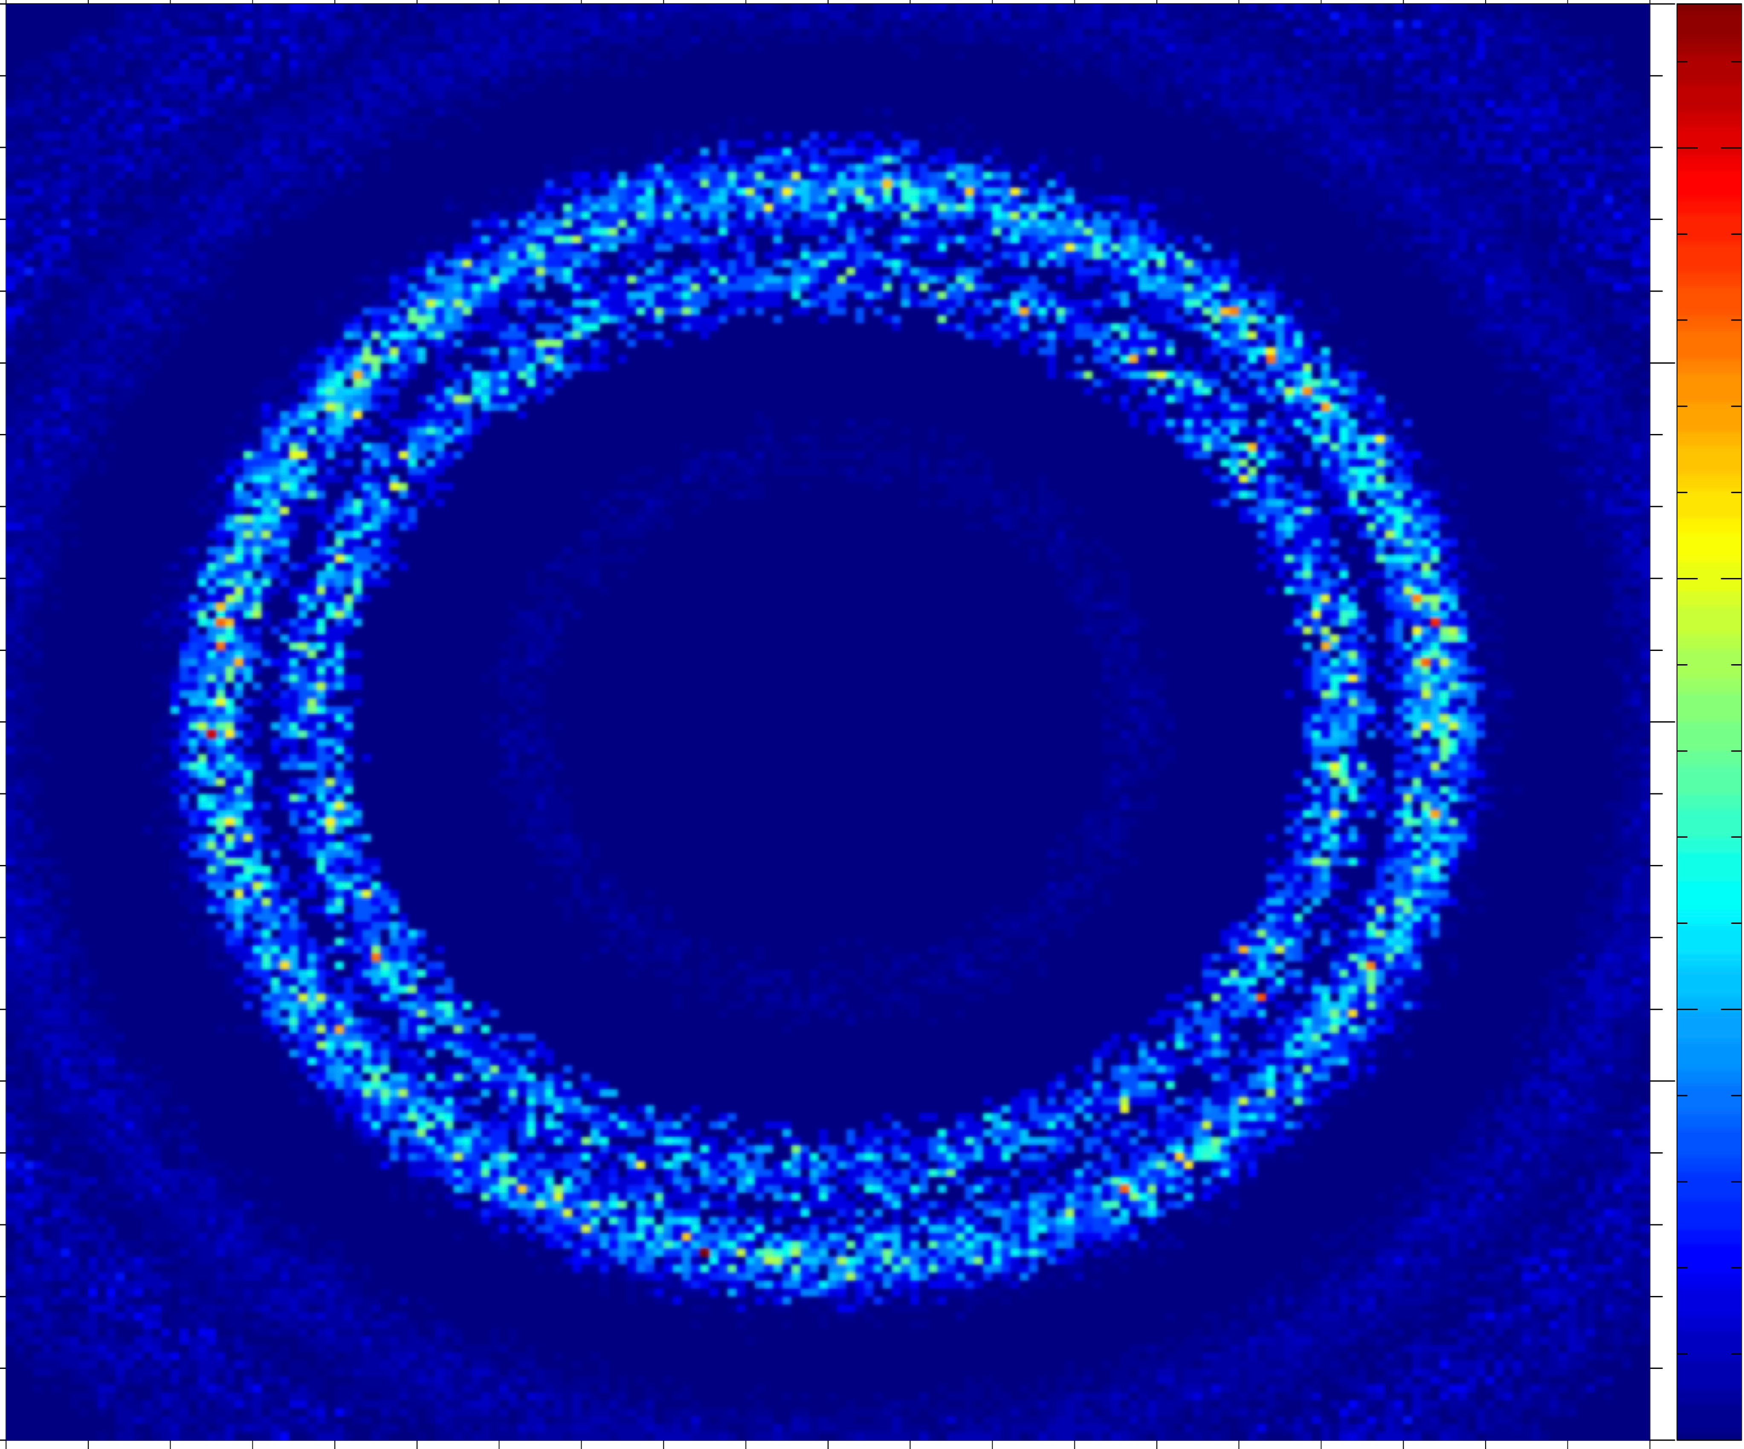
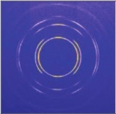
From single crystal / crystallites to powder….
Single crystal
Polycrystal with a little disorder, i.e. a preferred orientation, texture
Powder with complete disorder

Slide 11
Powder SX combination
Use a GROUP!
… but also allow reentry – How?
COMPONENT a1 = Arm()
AT(0,0,0) RELATIVE sample_pos
EXTEND
%{
sample_scatter=0;
%}
COMPONENT pow = PowderN( … )
AT(0,h/2,0) RELATIVE a1
GROUP sample
EXTEND
%{
if(SCATTERED) sample_scatter=1;
%}
COMPONENT sx = Single_crystal( …)
AT(0,-h/2,0) RELATIVE a1
GROUP sample
EXTEND
%{
if(SCATTERED) sample_scatter=1;
%}
COMPONENT a2 = Arm()
AT (0,0,0) RELATIVE a1
WHEN (sample_scatter) JUMP a1
Powder
Single Crystal

Slide 12
Extending that idea
A polycrystal as many Single crystals
The idea: Cheat a single Single_crystal into believing it is many...

Slide 13
Apply translation

Slide 14
Single_crystal as polycrystal
Scattering events happen in the crystal neutron exits.
Apply translation

Slide 15
Single_crystal as polycrystal
Apply inverse translation
Scattering events happen in the crystal neutron exits.
Apply translation

Slide 16
Single_crystal as polycrystal
Apply inverse translation
Neutron may enter a new subcrystal...
Scattering events happen in the crystal neutron exits.
Apply translation

Slide 17
J-PARC SENJU POLY
Let us take a look at a couple of “real” instrument simulations of Laue Cameras:
They both reside in GitHub under today / 3_Laue_diffractometers_TOPAZ\& SENJU/
1. SNS TOPAZ
2. J.PARC SENJU (aka. BL18)
3. J.PARC SENJU POLY
Here you need to also copy a datafile for the J-PARC source “source_BL18.txt”
Surgeon General’s Warning: There are lots of COMPONENTS here

